Slide 1

Global SQL
Transforming Global Language into SQL Queries
Adarsh | Selinam

Slide 2
Project overview
Involves 2 crucial stages:
Translating Global Language to English.
Converting English into SQL queries.

Slide 3
Model 1: Translating Global Languages to English
Step 1
Data Preparation:
Load & preprocess sentence pairs
Create word mappings & manage counts
Step 2
Seq2Seq Model Setup
Construct encoder-decoder architecture
Implement GRU encoder, RNN decoders
Step 3
Training the Model
Prepare data & tensors
Train with teacher forcing
Step 4
Evaluation & Analysis
Evaluate random translations
Visualize attention weights

Slide 4
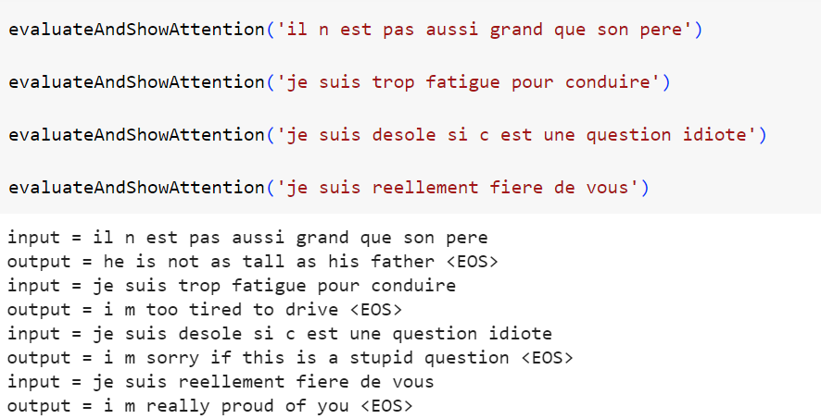
FRENch to English – PREDICTION RESULTS
Training Loss : 0.02
Accuracy : 78%

Slide 5
Model 2: Converting ENGLISH TO SQL QUERIES
Step 1
Data Preparation:
Load NL and SQL data.
Tokenize and create unique indices.
Prepare sequences and pad for model input.
Step 2
Encoder-Decoder Model Setup
Build an LSTM-based Encoder.
Construct a Decoder with LSTM cells.
Compile the model with appropriate loss and optimizer.
Step 3
Training the Model
Train the model on prepared data.
Monitor loss and accuracy during training.
Validate the model performance.
Step 4
Inference and Evaluation
Evaluate model accuracy on test data.
Perform inference on unseen data.
Check generated SQL query accuracy.

Slide 6
Model Architecture for NL-to-SQL Conversion
Encoder Architecture: Captures NL sequence information, generating final hidden and cell states.
Input (NL Sequences): Index-encoded NL tokens
LSTM Layer (Encoder):
Type: LSTM
Units: 64
Return Sequences: False
Return State: True
Decoder Architecture: Utilizes Encoder's context to decode NL into SQL queries, producing final SQL output.
Input (SQL Sequences): Index-encoded SQL tokens
LSTM Layer (Decoder):
Type: LSTM
Units: 64
Return Sequences: True
Return State: True
Dense Layer (Output): Utilizes Encoder's context to decode NL into SQL queries, producing final SQL output.
Activation: Softmax

Slide 7
ENGLISH TO SQL – PREDICTION RESULTS
NL :what flights go from dallas to phoenix
SQL : SELECT DISTINCT flight.flight_id FROM flight WHERE ( flight.from_airport IN ( SELECT airport_service.airport_code FROM airport_service WHERE airport_service.city_code IN ( SELECT city.city_code FROM city WHERE city.city_name = 'DALLAS' )) AND flight.to_airport IN ( SELECT airport_service.airport_code FROM airport_service WHERE airport_service.city_code IN ( SELECT city.city_code FROM city WHERE city.city_name = 'PHOENIX' )) )

Slide 8
OVERALL MODEL - PERFORMANCE
Evaluation: The model accurately translates natural language queries to SQL queries in 55.25% of cases on unseen test data.
Implication: Represents moderate performance in NL-to-SQL conversion, with scope for further analysis and improvement.

Slide 9
Use Case: Global SQL
Application: The model's versatility extends to translating from diverse global languages to SQL.
Potential: With extensive training and diverse datasets, it comprehends and converts instructions from any language into structured SQL queries.
Flexibility: Enables seamless database querying across multilingual contexts, easing language barriers in SQL interactions.

